Slide 1
Questions:
Presenting:
Next Steps:
Does the formatting need to be landscape? Is landscape an option? 16:9?
Is it possible to generate dynamic graphics of the selected region?
Are regions to be strictly defined by zip code or county jurisdiction?
Can you upload the excel sheet of indicators
How expansive do we want this?
Two Mark-ups
One based on UC Medicine’s community profiles
Pros: room for elaboration, graphics or data visualizations
Cons: longer, more work is needed to make it look visually appealing
One based on America’s health rankings
Pros: short, condensed, easy to compare against other community profiles in this format
Cons: no graphics or data visualizations
Third option – combine the two formats
Address feedback
Determine which health indicators to include

Slide 2
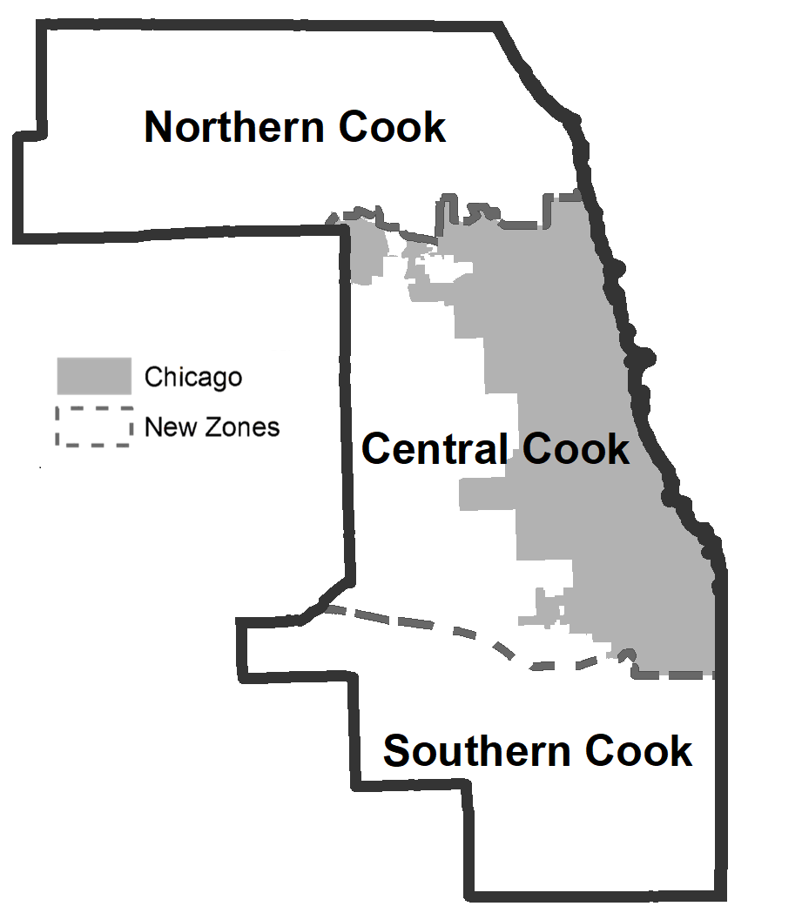
Community Profile: Suburban Cook County, IL 6000, 6001, 6002 | 2010-2020
All Measures
Summary
Change in median household income
Change in average life expectancy
Leading cause of infant mortality
Leading cause of mortality
Notes:
Include
Birthrate
Low birthweight
Received needed care

Slide 3
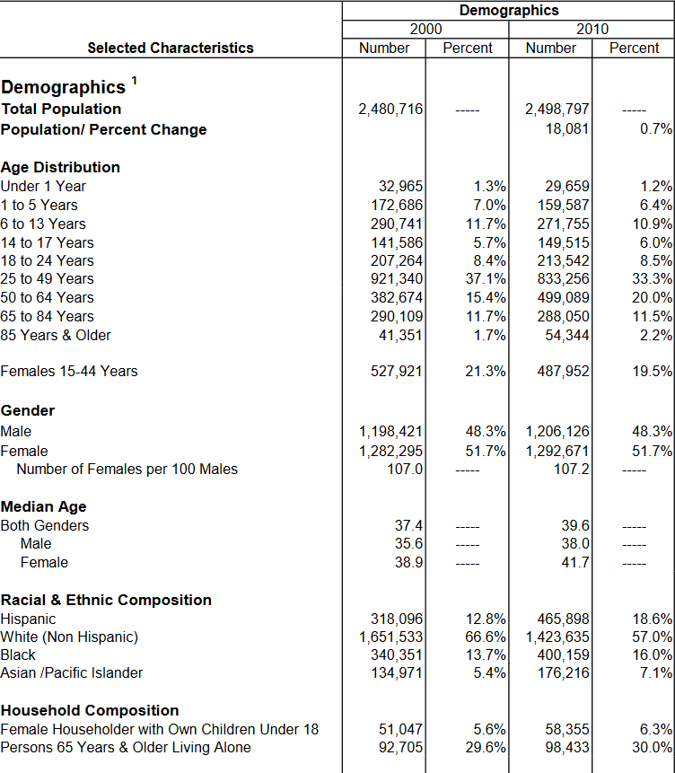
Demographics | Who Lives Here?
Space for graphics
Narrative Summary (also highlights changes in trends)

Slide 4
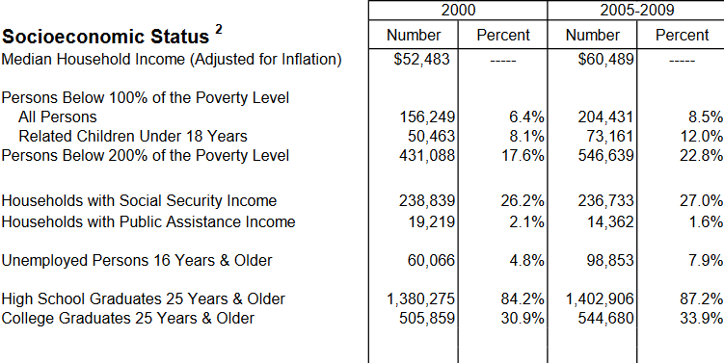
Socioeconomic Status
Narrative Description in regards to the SDOH
Space for graphics
Narrative Summary (also highlights changes in trends)
Notes:
Graphics emphasize the most up-to-date statistics

Slide 5
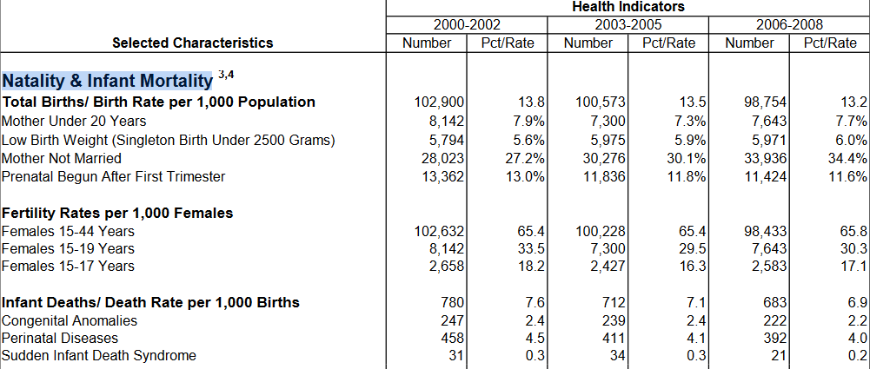
Natality & Infant Mortality
Narrative Description in regards to the SDOH
Space for graphics
Narrative Summary (also highlights changes in trends)
Notes:
Graphics emphasize the most up-to-date statistics

Slide 6
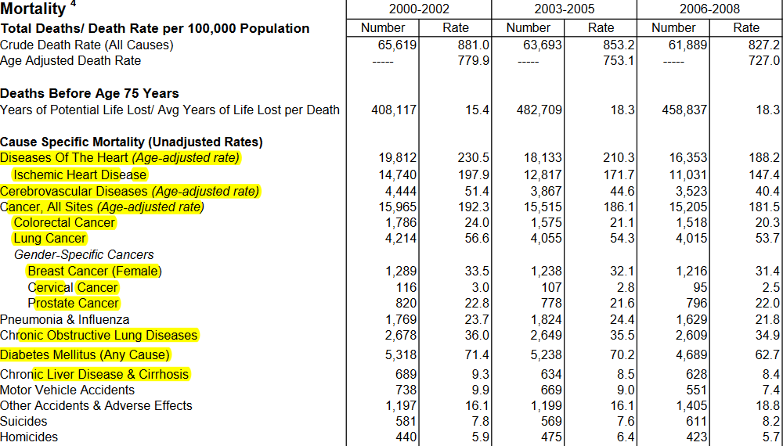
Mortality
Narrative Description in regards to the SDOH
Space for graphics
Narrative Summary (also highlights changes in trends)
Notes:
Graphics emphasize the most up-to-date statistics

Slide 7
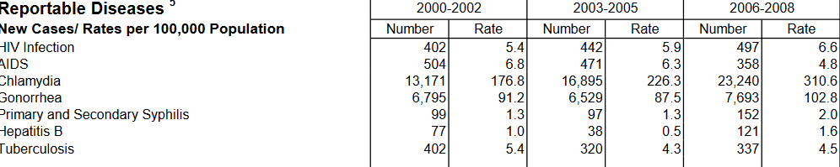
Reportable Diseases
Narrative Description in regards to the SDOH
Space for graphics
Narrative Summary (also highlights changes in trends)
Notes:
Graphics emphasize the most up-to-date statistics

Slide 8
Access to Health Care
Narrative Description in regards to the SDOH
Uninsured Rate
Primary Care Providers per capita
Mental Health Providers
Received needed care
Routine check-up rate
Space for graphics
Narrative Summary (also highlights changes in trends)
Notes:
Graphics emphasize the most up-to-date statistics

Slide 9
Built Environment
Narrative Description in regards to the SDOH
Drinking water quality rate
Low food access (%)
Housing
Crowded
Eviction Rate
Median Home value
Housing cost burden
Severe housing cost burden
Neighborhood violence rate
Particulate matter concentration
Reliable internet access rate
Space for graphics
Narrative Summary (also highlights changes in trends)
Notes:
Missing indicators:
Number of hospitals, clinics, CBT

Slide 10
Suburban Cook County Region
Summary
Strengths
Challenges
Highlights
Measures

Slide 11
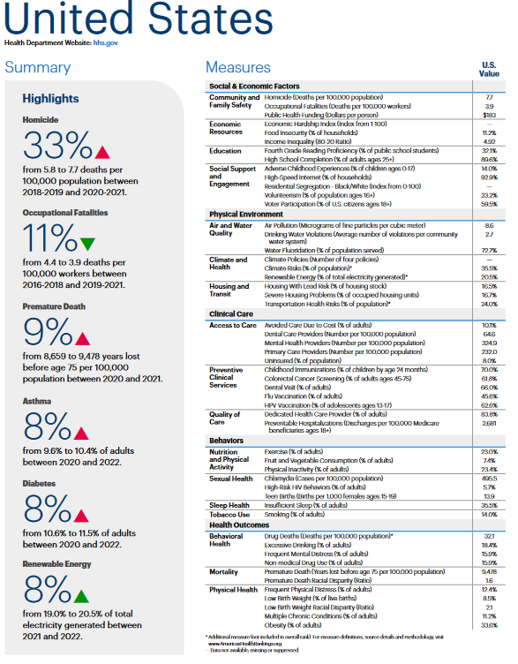
Source: America's Health Rankings

Slide 12
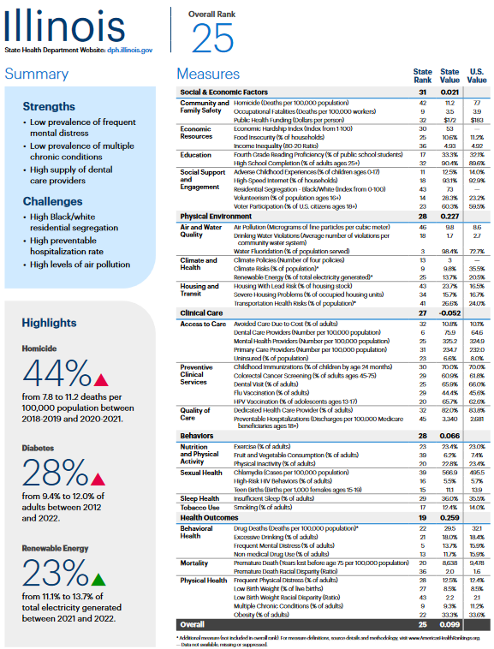

Slide 13
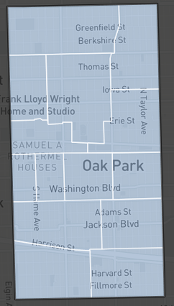
Appendix A

